Slide 1
PREVENTION AND DETECTION OF FAKE CHEQUE SCAMS USING BLOCK CHAIN
BATCH A13
SRIMANJARI P [211418104262]
SUBRINI K B [211418104270]
SWETHA A R [211418104283]
TEAM MEMBERS :
GUIDE NAME: Mrs.S.T.SANTHANALAKSHMI

Slide 2
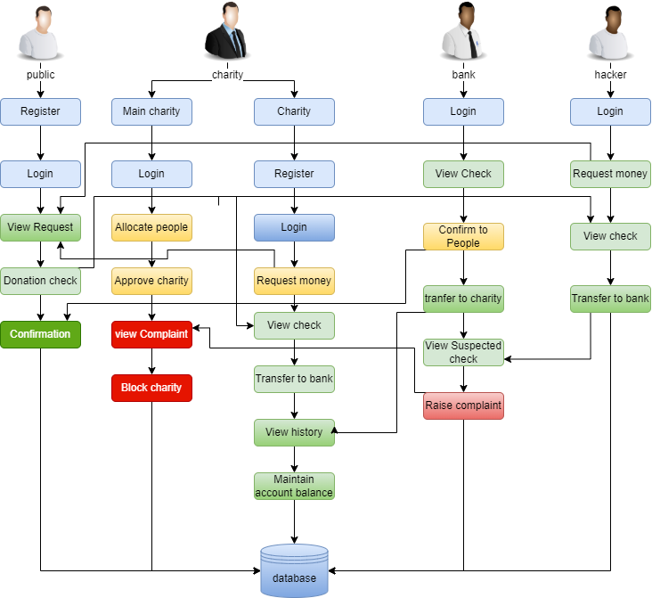
SYSTEM ARCHITECTURE

Slide 3
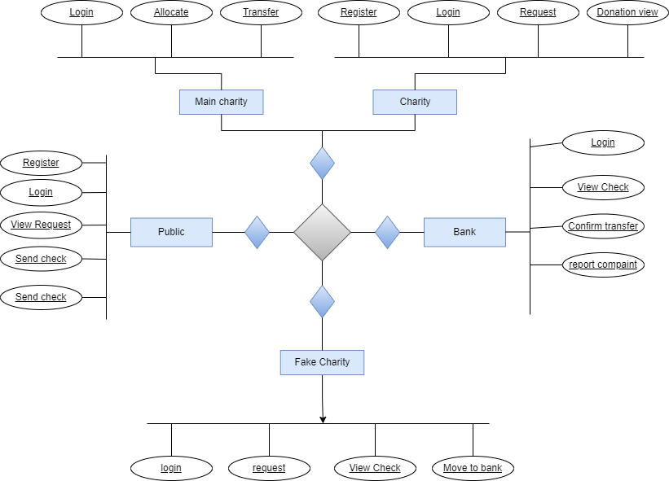

E-R DIAGRAM

Slide 4
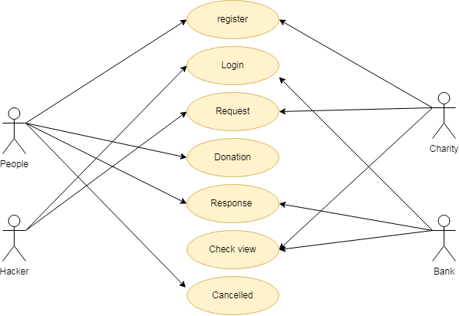
USE CASE DIAGRAM

Slide 5
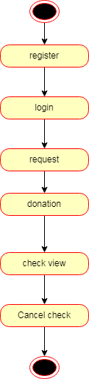
STATE DIAGRAM

Slide 6
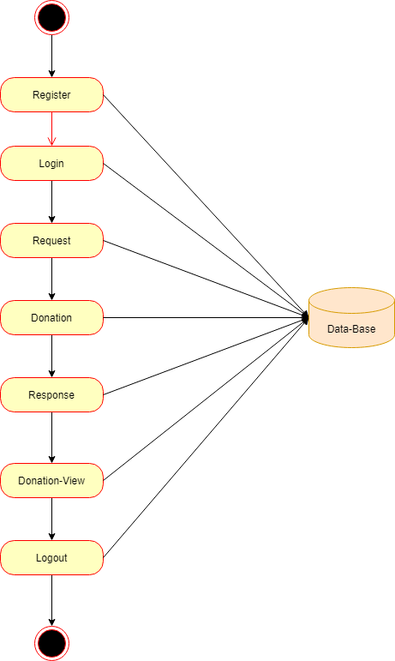
ACTIVITY DIAGRAM:

Slide 7
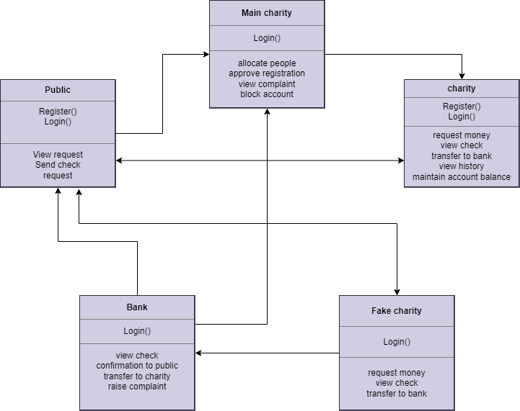
CLASS DIGRAM

Slide 8
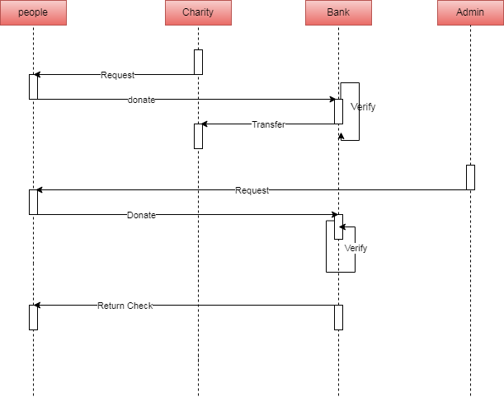
SEQUENCE DIAGRAM:
Hacker

Slide 9
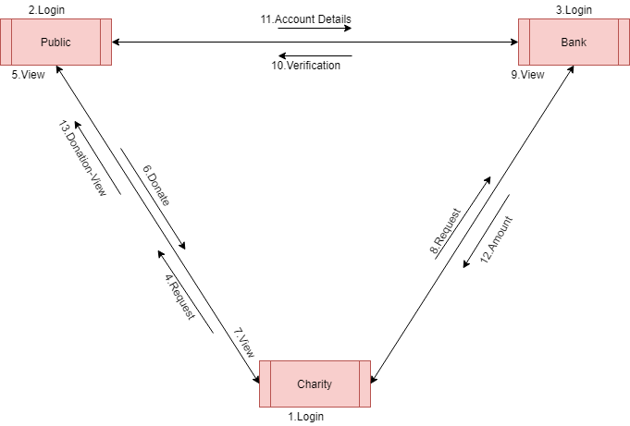
COLLABORATION DIAGRAM

Slide 10
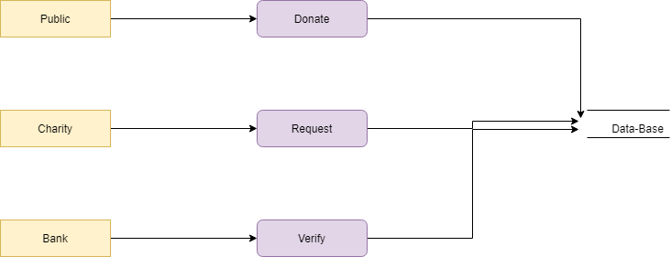
DATAFLOW DIAGRAM
LEVEL 0:
LEVEL 1:

Slide 11
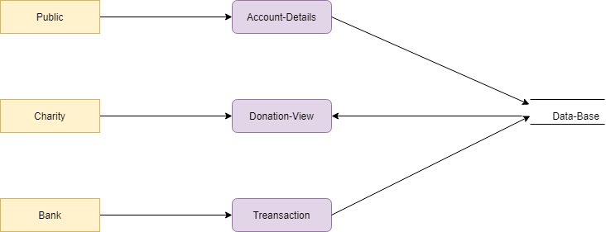
LEVEL 2:

Slide 12
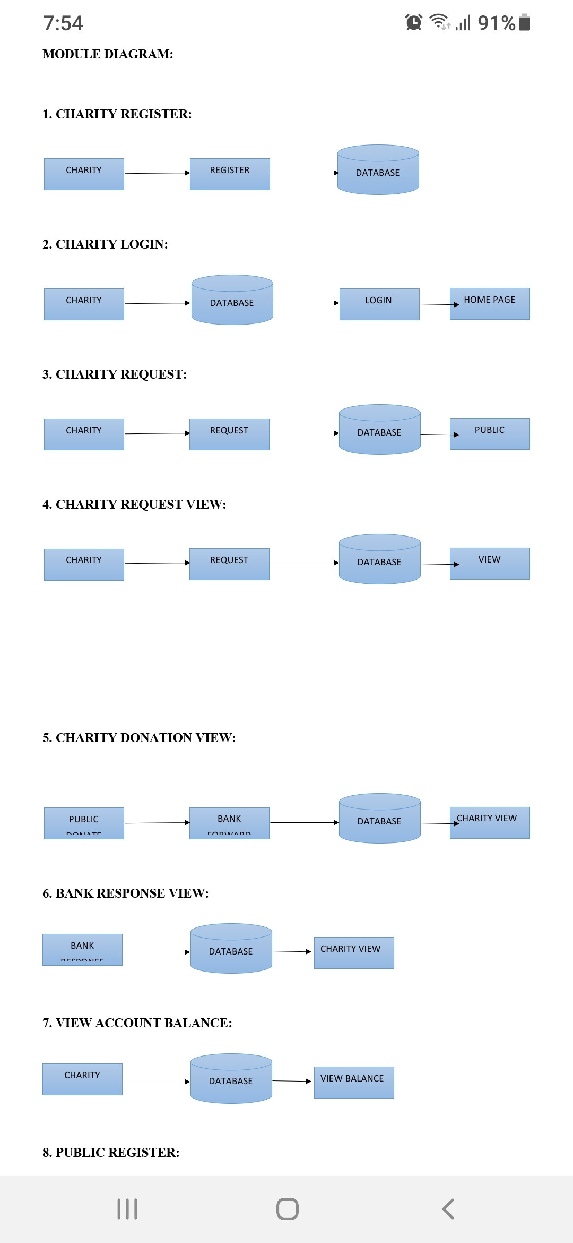
MODULES
1. CHARITY REGISTER:
The register module provides a conceptual framework for entering data on those charity in a way that: eases data entry & accuracy by matching the charity entry to the data source (usually paper files created at point of care), ties easily back to individual charity records to connect registers to charity data, and collects data elements to enable better supervision of donation programs.

Slide 13
2. CHARITY LOGIN:
Add a subheadingIn this module in our project, here symbolizes a unit of work performed within a database management system (or similar system) against a database, and treated in a coherent and reliable way independent of other transactions. A transaction generally represents any change in database user will transfer the amount to provider.

Slide 14
In this module is used to help to the user to Request for donation with the land longitude and the user will update the report along with their opinion and the will be stored the database.
3. CHARITY REQUEST:
4. CHARITY REQUEST VIEW:
In this module the charity will also view the request. And analysis the details will be responsible for your file stored in database.

Slide 15
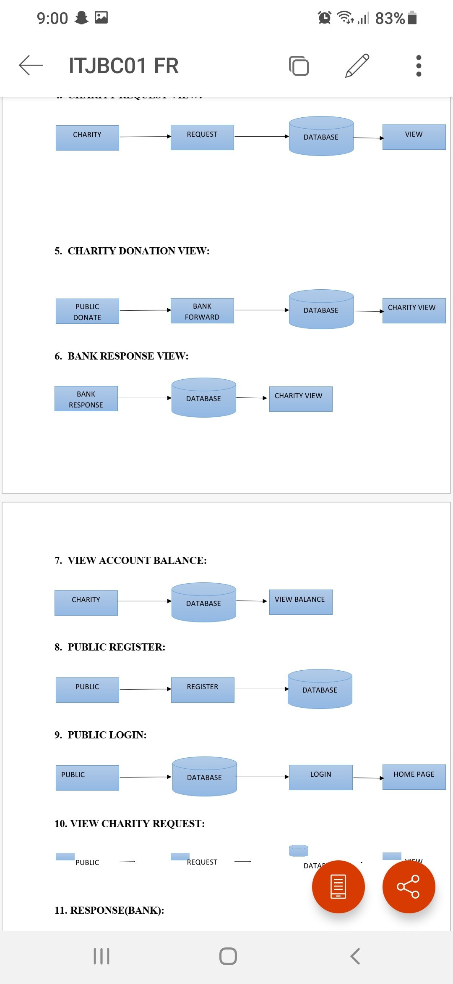
5. CHARITY DONATION VIEW:
In this module the charity will also view the donation. And analysis the details will be responsible for your file stored in database.
6. BANK RESPONSE VIEW:
In this module the charity will also view the donation. And analysis the details will be responsible for your file stored in database.

Slide 16
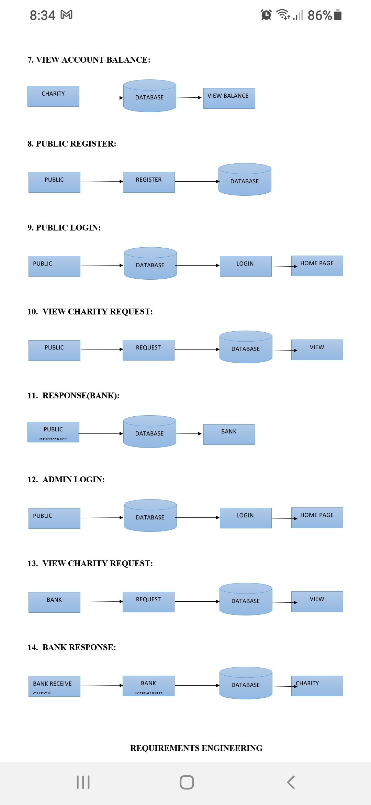
7. VIEW ACCOUNT BALANCE:
In this module the charity will also view the account balance. And analysis the details will be responsible for your file stored in database.
8. PUBLIC REGISTER:
The register module provides a conceptual framework for entering data on those charity in a way that: eases data entry & accuracy by matching the charity entry to the data source (usually paper files created at point of care), ties easily back to individual charity records to connect registers to charity data, and collects data elements to enable better supervision of donation programs.

Slide 17
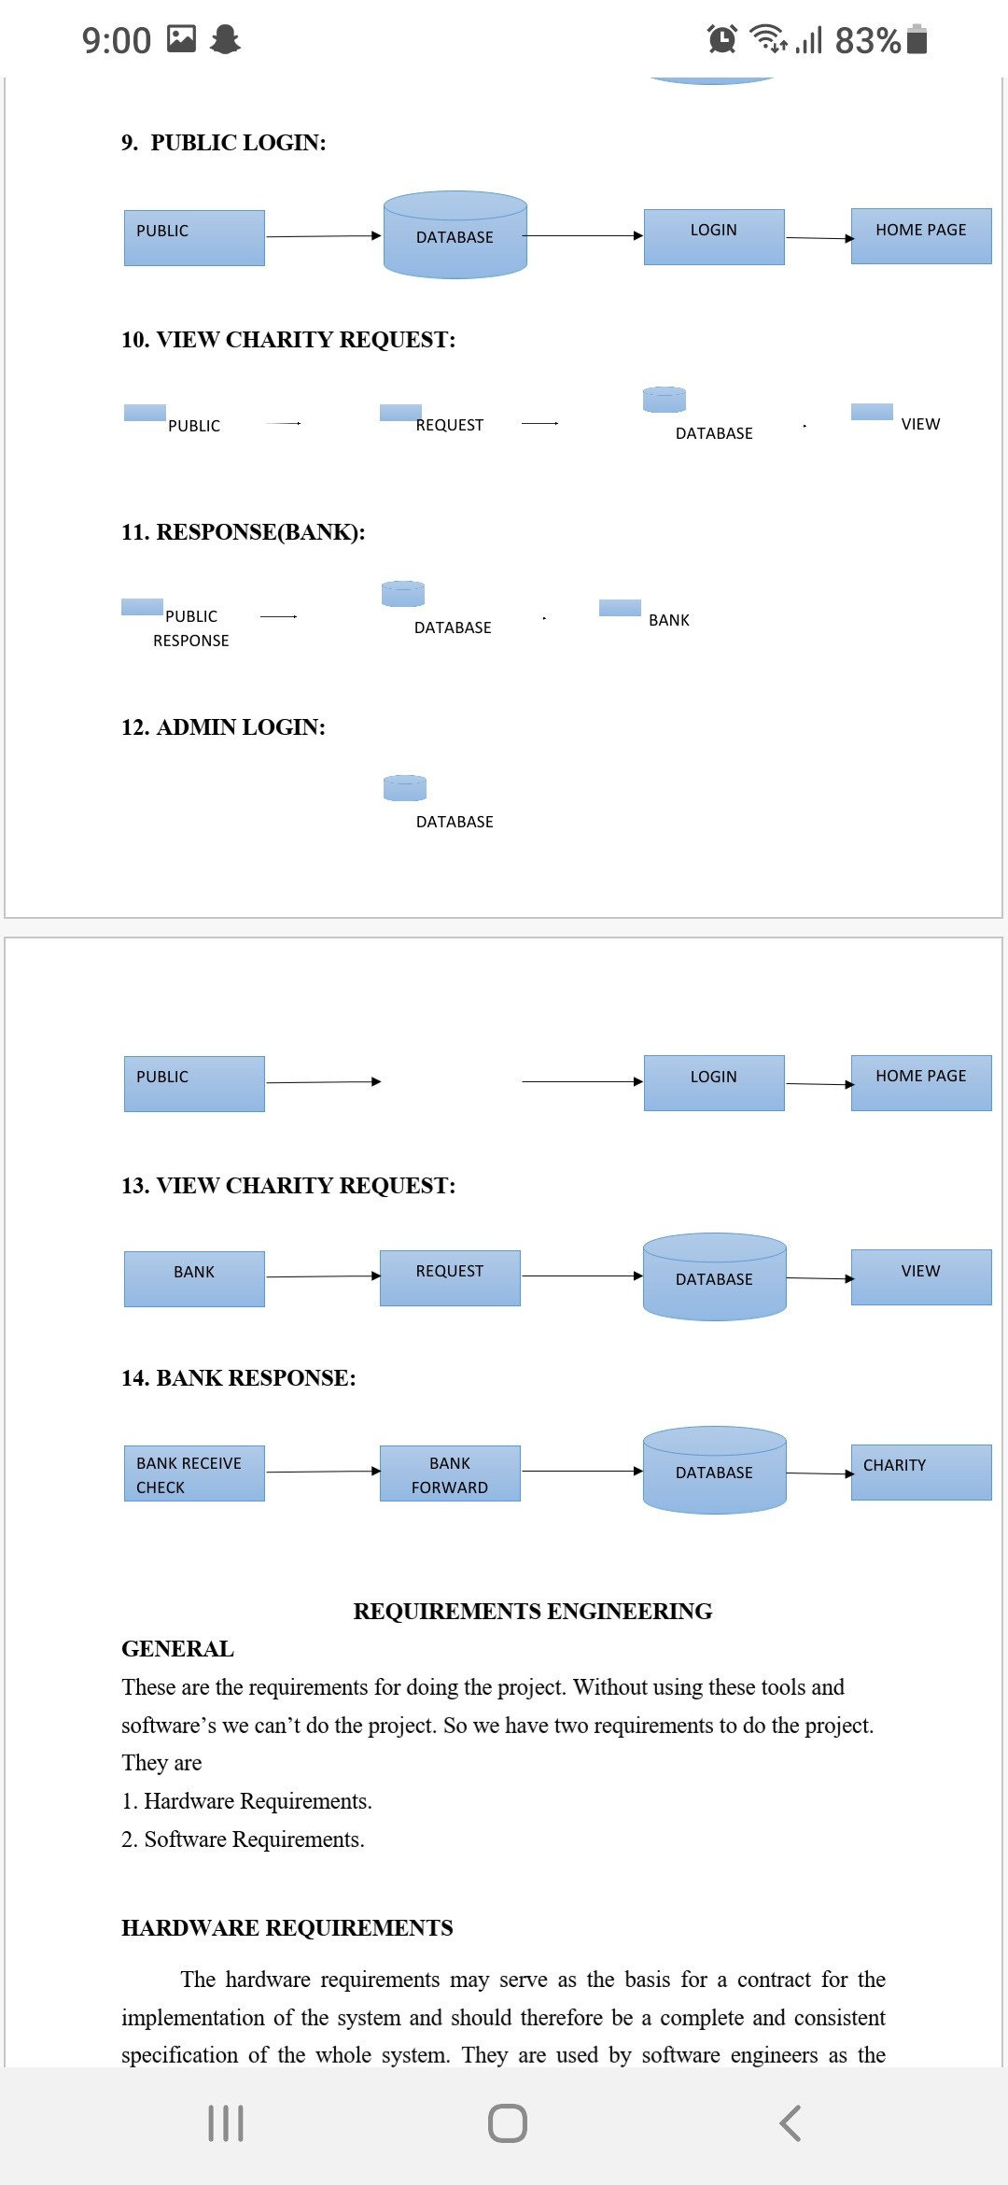
9. PUBLIC LOGIN:
In this module in our project, here symbolizes a unit of work performed within a database management system (or similar system) against a database, and treated in a coherent and reliable way independent of other transactions. A transaction generally represents any change in database user will transfer the amount to provider.
10. RESPONSE:
In this module the bank will response the data file fully analyzed data in category wise view Bank will be responsible for your file stored in database.

Slide 18
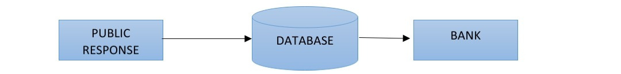
11. RESPONSE (BANK):
In this module is used to help to the public to donation the amount with the land longitude and the public will update the report along with their opinion and the will be stored the database.
12. ADMIN LOGIN:
In this module in our project, here symbolizes a unit of work performed within a database management system (or similar system) against a database, and treated in a coherent and reliable way independent of other transactions. A transaction generally represents any change in database user will transfer the amount to provider.

Slide 19
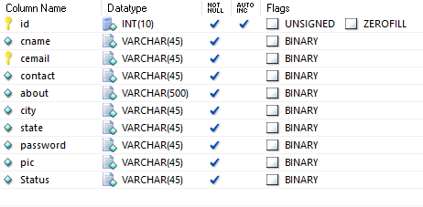
DATA DICTIONARY
CHARITY REGISTER

Slide 20
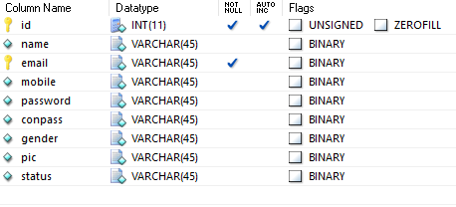
PUBLIC REGISTER

Slide 21
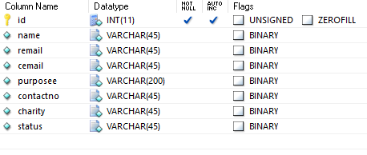
CHARITY REQUEST

Slide 22
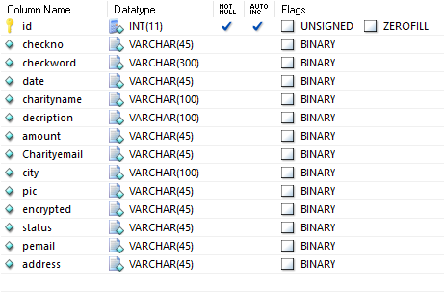
CHECK DETAILS

Slide 23
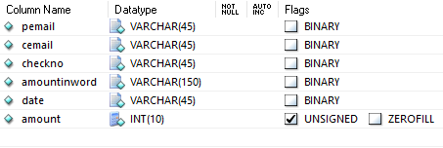
MONEY TRANSFERRED

Slide 24
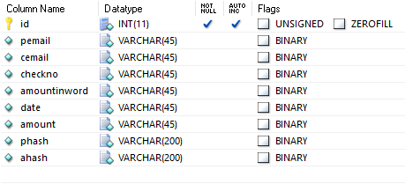
MONEY TRANSFERRING

Slide 25

SNAP SHOTS
MAIN PAGE

Slide 26
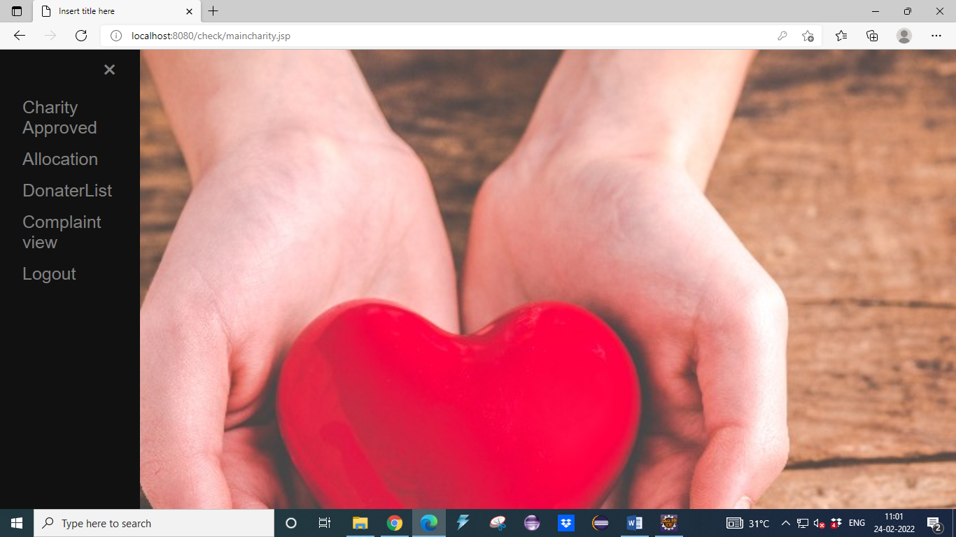
CHARITY MAIN PAGE

Slide 27
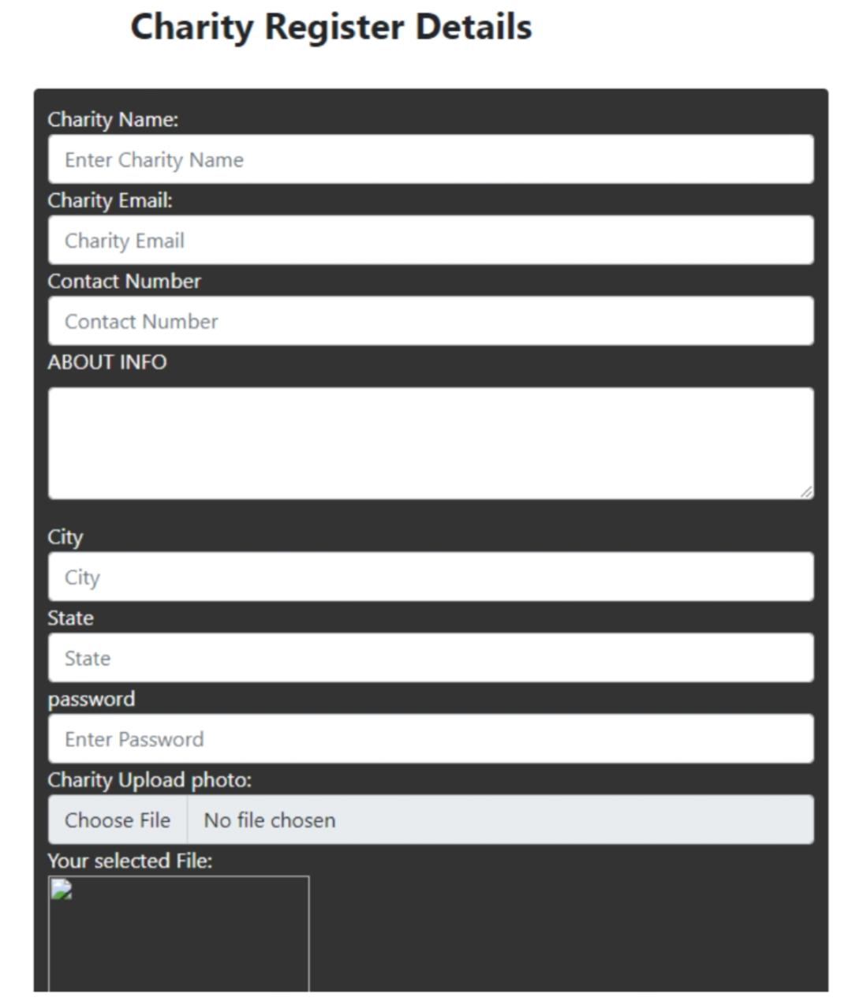
CHARITY REGISTER PAGE

Slide 28
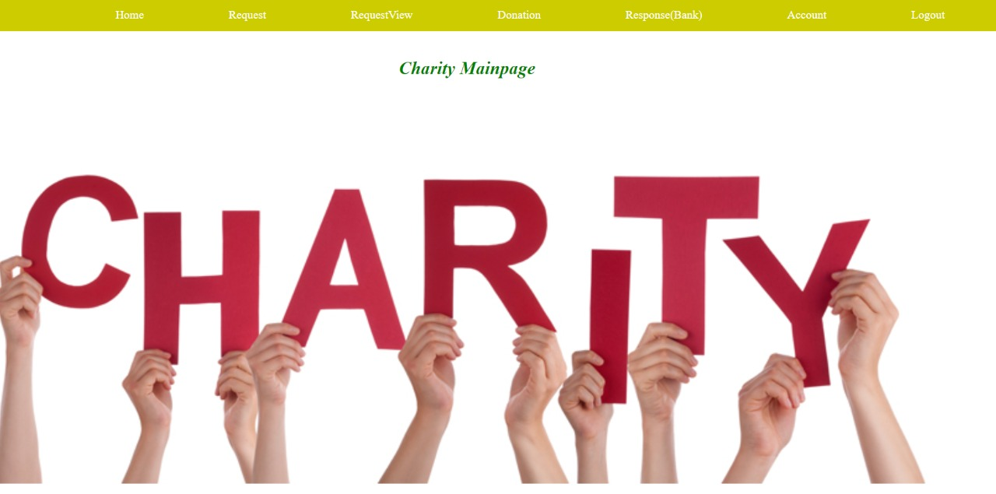
CHARITY MAIN PAGE

Slide 29
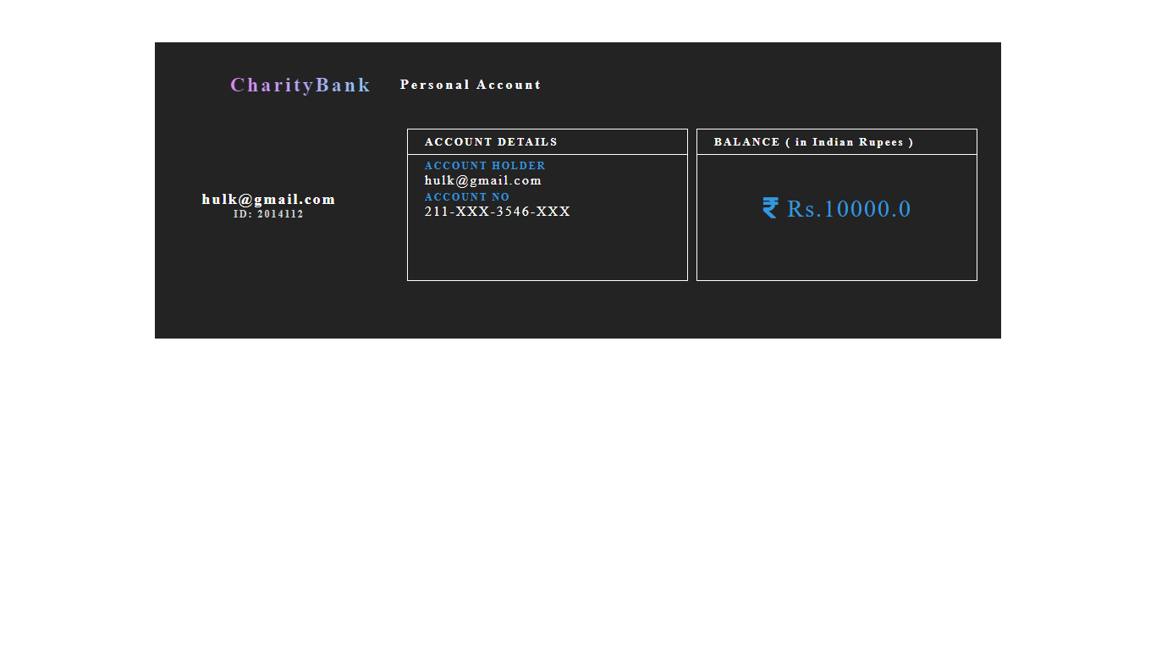
CHARITY ACCOUNT VIEW

Slide 30
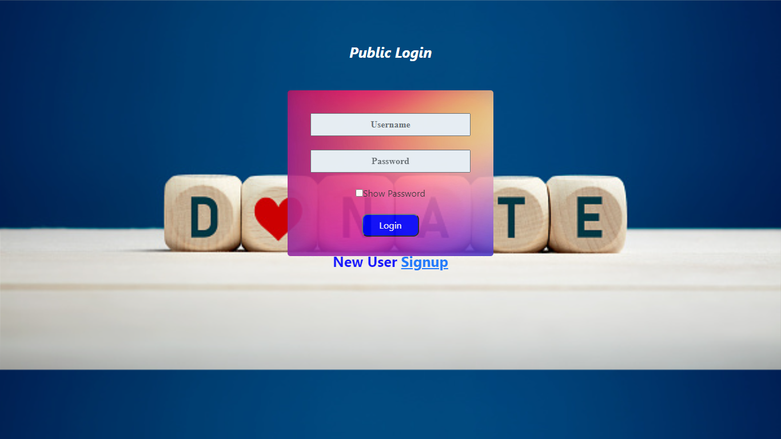
PUBLIC LOGIN PAGE:

Slide 31
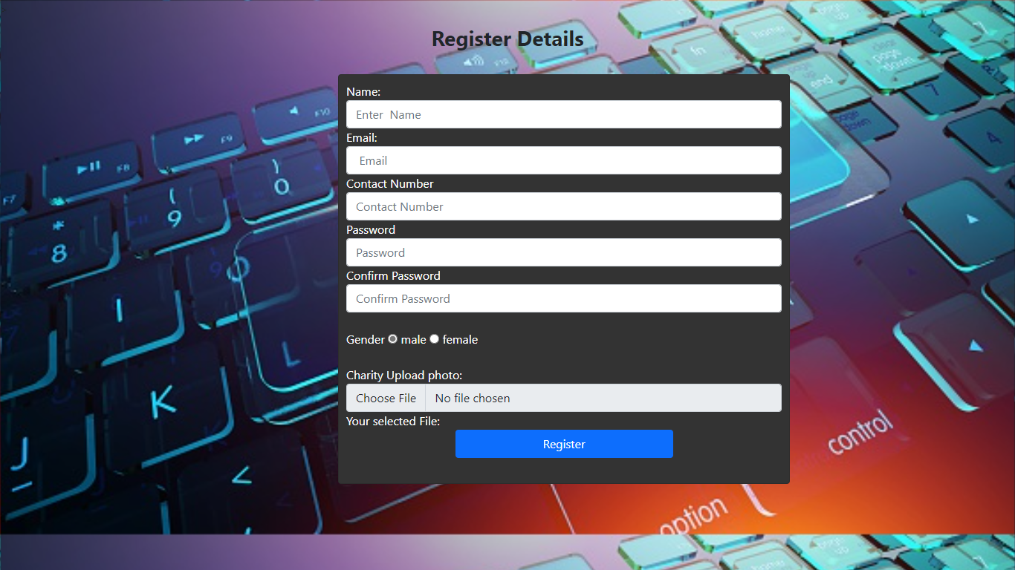
PUBLIC REGISTER PAGE

Slide 32
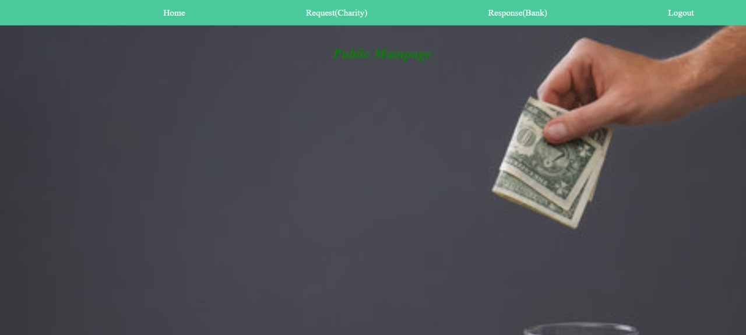
PUBLIC MAIN PAGE

Slide 33
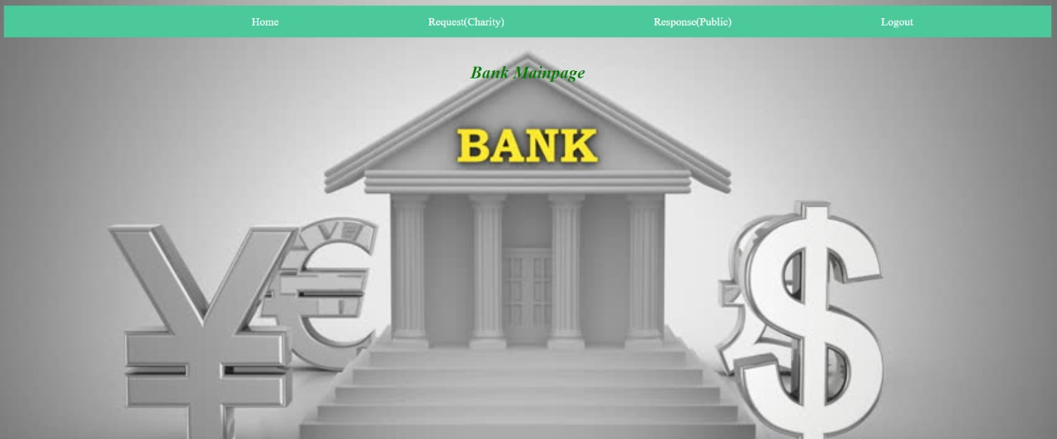
BANK MAIN PAGE

Slide 34
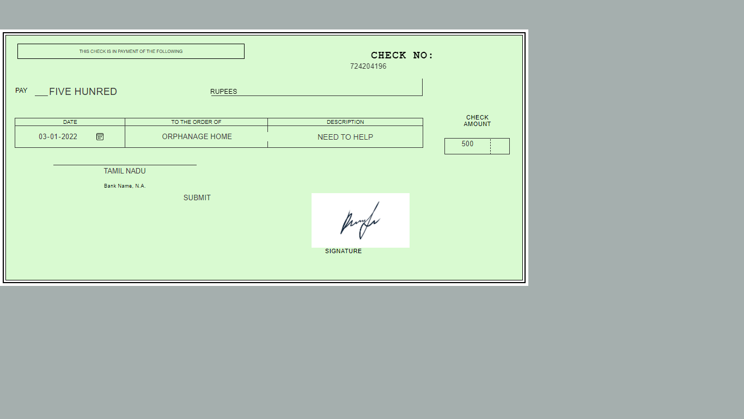
CHEQUE VIEW PAGE

Slide 35
ALGORITHM USED:
SHA ALGORITHM
In the field of cryptography and crypt analytics, the SHA-1 algorithm is a crypt-formatted hash function that is used to take a smaller input and produces a string that is 160 bits, also known as 20-byte hash value long.
The hash value therefore generated, is known as a message digest which is typically rendered and produced as a hexadecimal number which is specifically 40 digits long.

Slide 36
CHARACTERISTICS
• The cryptographic hash functions are utilized and used to keep and store the secured form of data by providing three different kinds of characteristics such as pre-image resistance, which is also known as the first level of image resistance, the second level of pre-image resistance and collision resistance.
The cornerstone lies in the fact that the pre-image crypt resistance technique
makes it hard and more time consuming for the hacker or the attacker to find the original intended message by providing the respective hash value.
• The security, therefore, is provided by the nature of a one way that has a function that is mostly the key component of the SHA algorithm. The pre-image resistance is important to clear off brute force attacks from a set of huge and powerful machines.

Slide 37
• Similarly, the second resistance technique is applied where the attacker has to go through a hard time decoding the next error message even when the first level of the message has been decrypted. The last and most difficult to crack is the collision resistance, making it extremely hard for the attacker to find two completely different messages which hash to the same hash value.
• Therefore, the ratio to the number of inputs and the outputs should be similar in fashion to comply with the pigeonhole principle. The collision resistance implies that finding two different sets of inputs that hash to the same hash is extremely difficult and therefore marks its safety.

Slide 38
USES OF SHA ALGORITHM:
These SHA algorithms are widely used in security protocols and applications, including the ones such as TLS, PGP, SSL, IPsec, and S/MiME.
These also find their place in all the majority of cryptanalytic techniques and coding standards which is mainly aimed to see the functioning and working of majorly all governmental as well as private organizations and institutions.
Major giants today such as Google, Microsoft, or Mozilla have started to recommend the use of SHA-3 and stop the usage of the SHA-1 algorithm.

Slide 39
THANK YOU

